Slide 1
Introduction to Block Map
Chen Gui <gui.chen@intel.com>

Slide 2
Sparse File
A filesystem is to map blocks of file data to disk sectors
Sector: a portion of a disk between a center, two radii and a corresponding arc (512 bytes)
Block: a sequence of bytes or bits, usually containing some whole number of records (4K bytes)
Hole: an unmapped area of a file
Sparse files are files with holes.
Sparse files help save disk space
Reading data from a hole returns zeroes
Writing data to a hole destroys it by forcing the filesystem to map corresponding file areas to disk sectors

Slide 3
Generate sparse file
Command
$ truncate -s4G image
Ioctl
fd = os.open(image, os.O_WRONLY)
os.ftruncate(fd, 2**32)
os.close(fd)
Show statics
$ stat image
File: ‘image’
Size: 4294967296 Blocks: 0 IO Block: 4096 regular file
Device: fd02h/64770d Inode: 49545842 Links: 1

Slide 4
Block Mapping
track disk blocks that are considered "in use“
Sparse file benefits by declaring a large file size but only allocating blocks that are actually used
To keep block mapping (also meaning ‘sparseness’)
Cp --sparse
Tar --sparse
To expand block mapping
Scp
Rsync

Slide 5
Find Block Mapping
FIBMAP ioctl
FIEMAP ioctl
SEEK_HOLE & SEEK_DATA

Slide 6
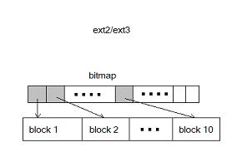
FIBMAP ioctl
From old days
Find block mapping block by block
for (i = 0; i < nr_blocks; i++) { int block = i; if (ioctl(fd, FIBMAP, &block)) { printf("ioctl failed: %s\n", strerror(errno)); } printf("%d\t", block); }

Slide 7
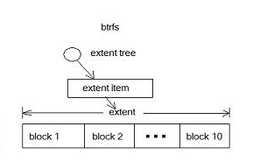
FIEMAP ioctl
From Kernel 2.6.28
Find block mapping extent by extent
ioctl(fd, FS_IOC_FIEMAP, fiemap);
for (i = 0; i < fiemap->fm_mapped_extents; i++) { printf("%-16.16llx %-16.16llx %-16.16llx %-4.4x\n",
fiemap->fm_extents[i].fe_logical,
fiemap->fm_extents[i].fe_physical,
fiemap->fm_extents[i].fe_length,
fiemap->fm_extents[i].fe_flags);
}

Slide 8
SEEK_HOLE & SEEK_DATA
LSEEK (from Kernel 3.1)
SEEK_HOLE
Adjust the file offset to the next hole in the file greater
than or equal to offset. If offset points into the middle of
a hole, then the file offset is set to offset. If there is no
hole past offset, then the file offset is adjusted to the end
of the file (i.e., there is an implicit hole at the end of any
file).
SEEK_DATA
Adjust the file offset to the next location in the file
greater than or equal to offset containing data. If offset
points to data, then the file offset is set to offset.

Slide 9
Q & A

